Slide 1

CODE REFRACTORING
AND
BUG FIXING

Slide 2
About me
Name: Nikhitha Reddy
Background
B-tech in Electronics and communication Engineering
Why you want to learn Data Science
As Data is generating from everywhere which is crucial for drawing insights and analysis. Also the Data science and Artificial Intelligence are going to rule the world in the coming years. So, with the interest to be in the part of this Domain and keen to draw insights, build models I chose Data Science.
Any work experience
Fresher
Share your linkedin and github profile urls
https://www.linkedin.com/in/nikhitha-chinthala/ https://github.com/Nikhitha-2310

Slide 3
Introduction
The task is about debugging and refining a Note Taking Application developed using Python, Flask, and HTML. The task presents a scenario where a team of data scientists embarked on a mission to create a Note Taking Application but encountered challenges due to their limited experience in backend development. As a result, the application failed to function seamlessly, prompting the need for a proficient backend developer to rectify the existing codebase.
The primary objective of this task is to identify and address the issues within the Note Taking Application's codebase, ensuring that the application functions as intended. Rather than starting from scratch, the focus is on analyzing the existing code, diagnosing the problems, and implementing necessary changes to make the application fully functional.

Slide 4
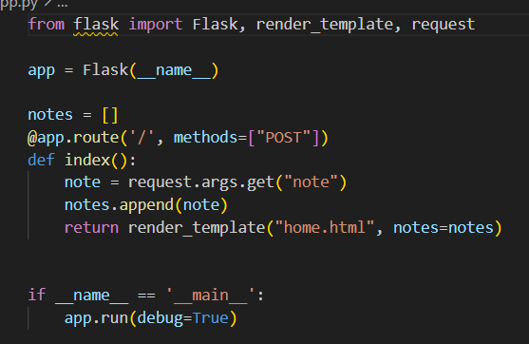
Bugs in the app
Here, it is using the requests.args.get method to get the note from the data, but this method is used to get data from the query string of the URL , not from the form data.
When the URL is accessed, it is calling only POST request.
Since there is not any template, it also shows template not found error when we try to execute it.

Slide 5
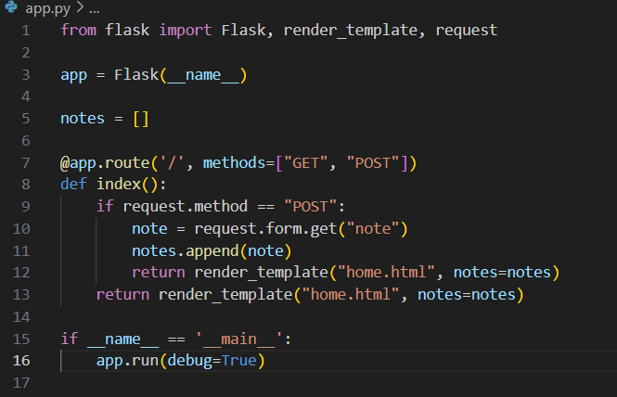
Fixing the bugs:
Here, instead of using requests.args.get method, to get the note from the data we used requests.form.get method.
When the URL is accessed, it has to call both GET and POST requests.

Slide 6
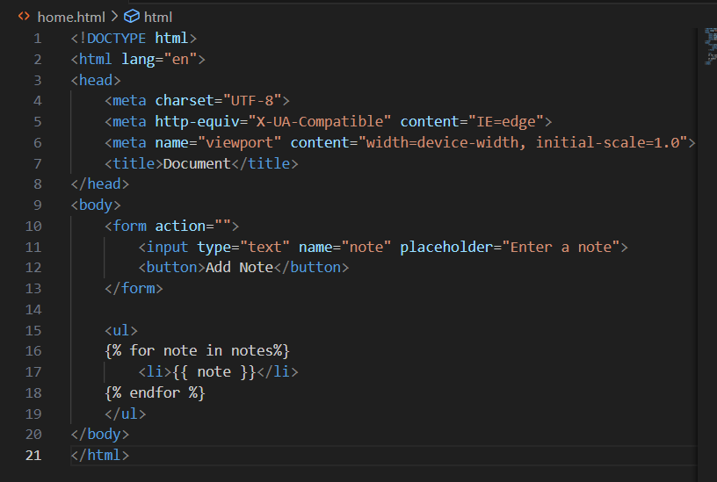
Bugs in the template
The form tag does not specify how the form data should be handled when submitted .It is lacking the method attribute.
The button tag is not specifying its type, so it defaults to button.

Slide 7
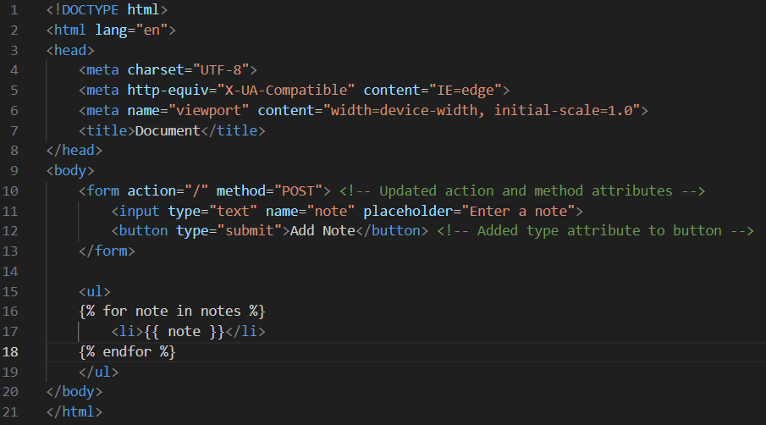
Fixing the bugs
<form> element allows users to input a note and submit it to the server.
Method=‘POST’ attribute indicates that the form data should be sent to the server using the POST method.
Placeholder=“Enter a note” allows the user on what to enter in the input field.
<button> element serves as the submit button for the form.
Below the form, an unordered list <ul> is used to display the list of notes.

Slide 8
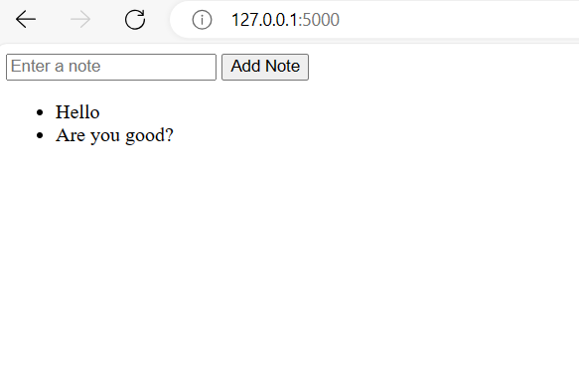
As we enter the note in the text box and click on the button “Add note” , it takes the note and creates an unordered list.
As we go on entering notes and add, an unordered list of notes will be created and displayed below.

Slide 9


Slide 10

THANK YOU

